Slide 1
Segmentation

Slide 2
Introduction
Social media segmentation is breaking down your audience demographics within and between different social media platforms.
It gives you an understanding of the different groups of people using various social media channels so you know which channels to employ to reach those groups.

Slide 3
Since the 1950s, when the practice of market segmentation began, it has been the cornerstone of any marketing strategy.
Accurately define your market segments and then the follow on activities of targeting and positioning are much more effective.
With the advent of social media marketing, many are asking whether social networks, and their ability to engage with individuals interactively and in real-time, made the practice of categorising people into groups redundant?
The answer has to be a resounding “No!”, but the way brands categorise consumers is changing.

Slide 4
1) Use social media targeting.
When most people think of social media segmentation, they think of paid targeting options. Facebook allows businesses to target their messages to users based on data such as user demographics, interests, and geographical location.
Other platforms including Twitter, LinkedIn, and Instagram have followed suit.
Paid targeting is effective because it enables companies to get a specific message in front of a specific audience.

Slide 5
Facebook
Facebook allows you to filter by gender, relationship status, age, location, interests and more.
Simply create your post and select the target audience of your choice.

Slide 6
LinkedIn
LinkedIn allows you to target by industry, company size, function and more.
This is a great feature for B2B companies that are seeking to attract more visitors.

Slide 7
2) Create a group.
Social media is all about community. Building communities of people who share common interests is an easy way to segment your audience and gain valuable insights.
You may decide to keep the group open (anyone can join) or closed (new members must be approved by a moderator) -- there are advantages to each.

Slide 8
3) Make a list.
Most marketers are familiar with creating lists
-- we do that every time we send a new email campaign.
But did you know you can use lists to have more productive social media conversations? Social networks like Facebook and Twitter allow users to create lists of friends, followers, people who have attended an event, and more.

Slide 9
4) Post at different times of the day.
We’ve all heard how important timing is to marketing, especially on social media. If you have a global following, you should be publishing posts throughout the day at the times most appropriate for different geographic regions.
Differentiating your publishing times allows you to get engagement from a larger portion of your audience.
Additionally, publishing a message more than once or at different times of the day can help your reach a specific audience that you haven't reached before.

Slide 10
5) Maintain multiple social media accounts on each network.
As you become a better marketer and master ways to segment your audience, more and more people from all over the world are going to be interested in connecting with you through social media.
At that point, you may find that the best way to consistently serve your audience relevant content is by setting up several social media accounts, each with a specific bent.

Slide 11
Visitor Vs Visitor type

Slide 12
Visitor
The term “visitor” refers to a user who visits a website. However, a visitor is not considered as a single person but as a browser or a terminal.
For example, a single user can access a website via different browsers (such as Google Chrome, Firefox or Microsoft Edge), different computers (at work and at home) or different terminals (smartphone and laptop).
If a visitor visits a page once in the morning and once in the evening, this user is counted as a single visitor with two visits. This same user will be considered a different visitor if they return to the site the next day.

Slide 13
Unique visitor
The measurement of unique visitors is based on cookies. A cookie is a file placed on a browser that contains an anonymous identifier. This ID can be used to uniquely identify a browser.
As a result of this measurement method (which is the basis of all current analytical systems), inaccuracies may occur.
For example, a browser may refuse to accept cookies, or a user may decide to delete them.
In most cases, however, a terminal has a cookie and is included in the calculation of unique visitors.

Slide 14
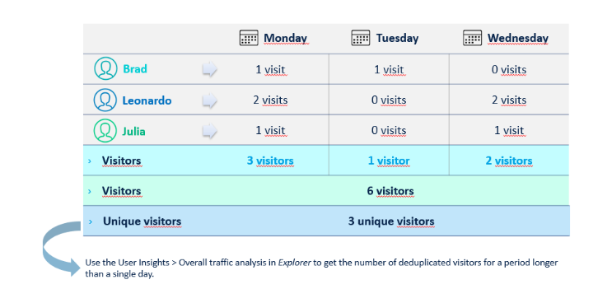
Example

Slide 15
Identified visitor
Identified visitors are measured using a unique identifier that is sent in the tagging when connecting to an authenticated space (login + password) and are common to all platforms (computer, tablets, smartphones…). It is this unique identifier that allows the cross-device analyses available in the User Insights module of the Analytics Suite.
Identified visitors should therefore not be considered as unique visitors. A unique identification of a unique user on different devices and browsers is only possible if the user actively identifies themselves. This is possible through a connection and can then be analysed using the “Identified Visitor” metric.

Slide 16
Visit
A visit is defined as a visit to a website where at least one page has been loaded. Visits indicate a continuous process of using a website and should not be confused with the number of visitors, as a visitor may make several visits to the same site.
It should be noted, however, that the period during which each visit is counted only once may vary considerably.
Internet calculates this metric in this way: if a visitor does not perform a new action within 30 minutes, a visit is considered complete. The number of visits to a website is expressed in relation to a specific period (day, week, month…).

Slide 17
The visit is fundamental for the preparation of most analyses.
The visit provides you with information on navigation (initial page, content viewed, exit page) and behaviour (duration, loads/page views, bounce rate, etc.).

Slide 18
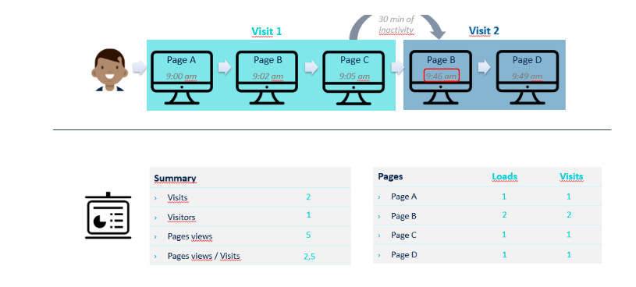
Example

Slide 19
There are different types of visits:
Total number of visits:
Total number of visits in a given period
Incoming visits:
Visits with at least two pages viewed
Bounce visits:
visits with only one page viewed

Slide 20
Cont...
A page view is the loading of a page from a website or application.
Each page viewed generates a hit that is sent to Internet.
Each of these occurrences increases the “page views” metric by 1.
the next graph illustrates its operating principle:

Slide 21
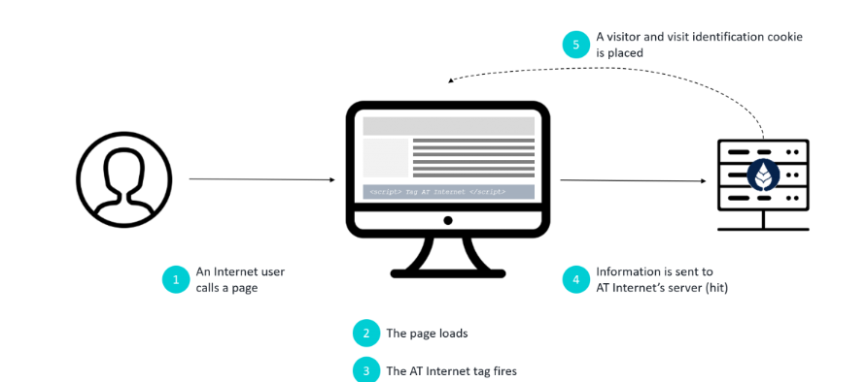

Slide 22
1. The User requests to load a page on the Site’s host server.
2. This server returns the page content (images, texts, etc. and the JavaScript code of the Internet AT tag).
3. The JavaScript tag is executed on the online user’s computer and collects information.
4. The tag requests an image on the Internet AT server and transmits the collected information as parameters.
5. The Internet AT server returns the requested image.

Slide 23
In Summary

Slide 24
Visit
A visit is a user’s journey through the site or application. A visit contains one or more page views. As soon as a user is inactive for 30 minutes because he has left the site or remained on the same page, a visit is considered complete.
Visitor
A visitor is a user of a website. If a visitor visits a page several times a day , with interruptions of more than 30 minutes, AT Internet considers him/her as a unique visitor who has generated several visits. If a visitor visits the website on two different days, he or she will be counted as two visitors. If the AT Internet cookie is deleted after each visit, this visitor is considered a new visitor for each new visit.

Slide 25
Unique visitor
On a single day, unique visitors correspond to the definition of “normal” visitors. However, if you look at a period of more than one day, these values differ due to the recognition of cookies. If a visitor has a cookie on his browser and visits the site twice on different dates, this visitor will be recognised as a unique visitor and counted only once in the analysis period.

Slide 26
types of visitors
As the Internet has become the primary source of lead generation for most businesses, displaying prices and offers on the web is an important part of the daily business mix.
Generally there are three types of visitors to your website.
1. Comparers – These are visitors who know what they want and they are comparing prices. These types are the people who if they were in your shop and you asked them if they needed assistance would say “No thanks we are just browsing”.
FACT: They will buy from someone and your offer needs to jump at them.

Slide 27
Contt...
2. Researchers – They may have a need for the product they are looking for either soon or for a coming up event, like moving house or upgrading etc. They are trying to work out what they need.
FACT: Your offering needs to be explanatory, researcher are info gatherers.
3. Buyers – These visitors are ready to buy. They could have been comparers and or researchers minutes ago or weeks ago. They are ready to buy.
FACT: Do you have pricing displayed?

Slide 28
Question
User | Page_A | Page_B | Page_C
A | Visted at 11:00 p.m | visited at 11:10p.m | Visited at 11:55p.m
B | Visted at 11:00 am on Monday | - | Visited at 11:00pm on Saturday from different terminal
C | Visted at 11:00 a.m | visited at 11:10a.m | Visited at 11:22a.m
D | - | - | Visited at 1 p.m
Visitors_Page Wise
Total_Visitors:
Unique_Visitors:
Page_View_D:
Page_visit_B:

Slide 29
Design an effective marketing campaign

Slide 30
Outline Your Individual/ Company Marketing Goals
Before you can plan any campaign, you need to understand and outline your overall marketing goals.
Establish SMART (Specific, Measurable, Attainable, Realistic and Timely) goals for best results.
Your goal might be to gain at least 10 new clients a month or to sell 10 products per week, or to increase your individual income by 30 percent this year). Goals can be based around sales, customer satisfaction or profits.

Slide 31
Determine Your Budget
Before you get started with research, you’ll want to determine a budget. Why?
Because persona research often costs money, and you’ll want to include these costs as part of your campaign budget.
Determining how much money you can spend early in the campaign planning process will help you determine your goals, strategy and even how much content you can create.

Slide 32
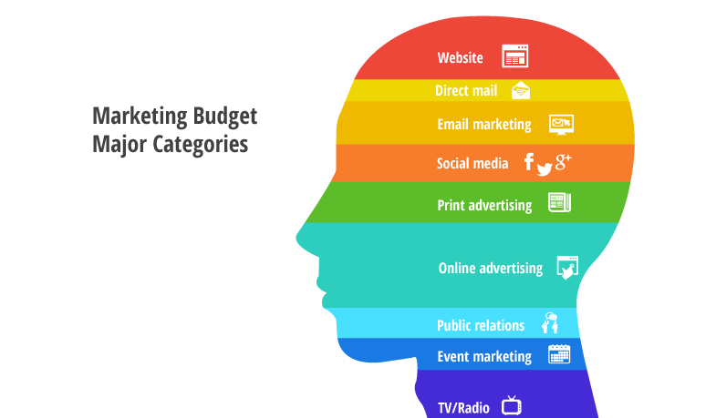

Slide 33
Perform Marketing Research
Describe your product or service and its features and benefits in detail, as well as how it’s different from the competition. Focus on all of the key features for your product(s) / service(s), including pricing, service, distribution and placement. Collect, organize and write down this information. Some areas to consider include:
Market dynamics, patterns such as seasonality
Product - what's currently available, what your competition is selling
Benchmarks in the industry
Potential vendors and partners that you will need to rely on

Slide 34
Write a few sentences that state:
Who your key market is
What you’re selling
Your USP : "unique selling proposition” (USP)

Slide 35
Determine Your Target Personas
First, describe your ideal target customer in terms of age, gender, family composition, earnings, likes and dislikes, lifestyle, purchasing patterns, buying objections, hobbies, etc..
Test your target customer assumptions.

Slide 36
Outline Campaign Goals
Once you’ve determined how you’ll sell your product and who you’ll sell it to, you can start to outline your specific campaign goals.
Here you will define “The Big Idea” for your campaign. This idea will determine how will you connect with and convince your audience.

Slide 37
A Marketing Campaign May Include the Following Elements:
Email
Social Media
SEO
PPC
Automation
Demand generation
Landing pages/ website/ e-commerce pages
Content (created, curated, etc.)
Events
Press Releases/PR
Analytics
“Direct” marketing (traditional media)-- magazines, print ads, fliers, etc.
CRM
Coupons
Demos/evaluations

Slide 38
Cont...
Content Creation
Promotion & Execution
Train Internally
Analyze

Slide 39
Analyze
Marketing campaigns are meant to be analyzed. You need to make sure that you’re spending your money on the right tactics and sending the most effective messages. Here are some of the many ways you can analyze your campaign’s performance and how you can measure them.
Number of organic website visits to your content (Google Analytics)
Time on page (Google Analytics)
Email open rates and click-throughs
Click-throughs and referrals from paid ads (Google Analytics)
Number of prospects earned at an event (various ways)
Engagement (likes, shares) on social media (paid social analytics tools such as Simply Measured, or free analytics from the social networks themselves)

Slide 40
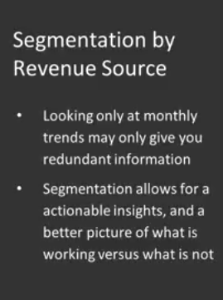
Segmentation by Revenue Source

Slide 41
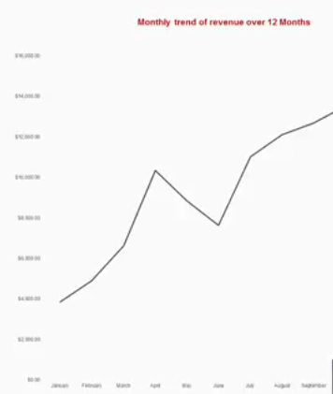
Example

Slide 42
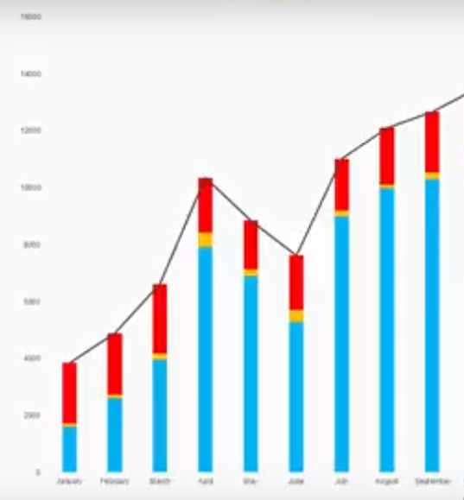
After including segmentation

Slide 43
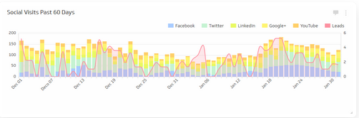
Example

Slide 44
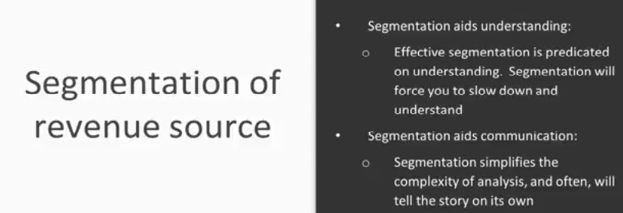

Slide 45
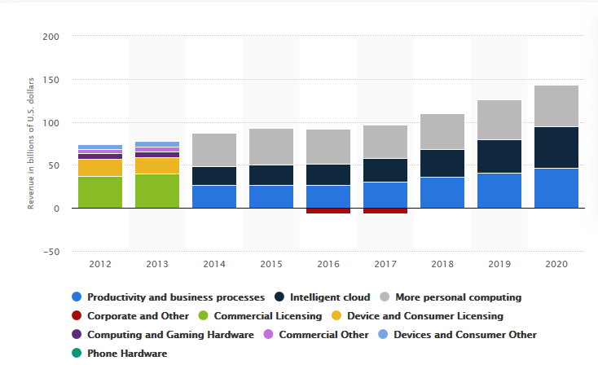

Slide 46
Social media platforms include “built-in analytics”.
These help you track key metrics like likes, shares, and clicks through to your website.
But they don’t give you the full picture of how traffic flows to your website from social channels, or how a visitor becomes a customer.

Slide 47
UTM parameters: UTM (Urchin Tracking Module) parameters.
“UTM parameters” might sound really technical, but they’re actually very simple and easy to use. They’re just short text codes that you add to all of the links in your social posts. They provide three key benefits:
They help you track the value of social marketing programs and campaigns.
They provide precise data about where traffic and conversions come from.
They allow you to test individual posts head-to-head in classic A/B testing style.

Slide 48
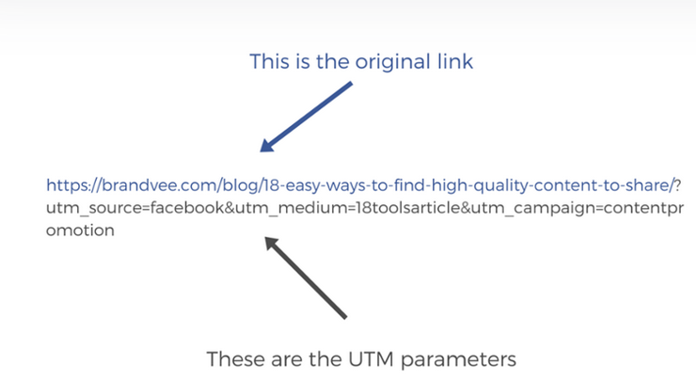

Slide 49
